Slide 1
Problem statement
The new strategy has been set to compensate the new operating cost. Based on appropriate method, number of visitors and current facilities, a new ticket price should be proposed to gain the benefit of $1540000 to cover operating cost in one year.

Slide 2
Scope of solution space
Getting statistical data regarding all of services, expenses and information of other resorts in the United States.
Based on this dataset, it is possible to make comparison between Big Mountain resort and other locations and it is feasible to have bench marketing.
In addition, data modelling can be utilized to predict the ticket price and estimation of revenue.

Slide 3
Recommendation
Adding run, increasing vertical drop and installation of additional chair lift support to increase the ticket price by $1.3 over the season.
Assuming the condition of previous approach and adding 2 acres of snow making can support to increase the ticket price by $1.3 over the season and the revenue is estimated about $2282609. Therefore, small increase of snow making area is not effective on the results.
Decrease the count of runs closed which causes direct impact on the ticket price.

Slide 4
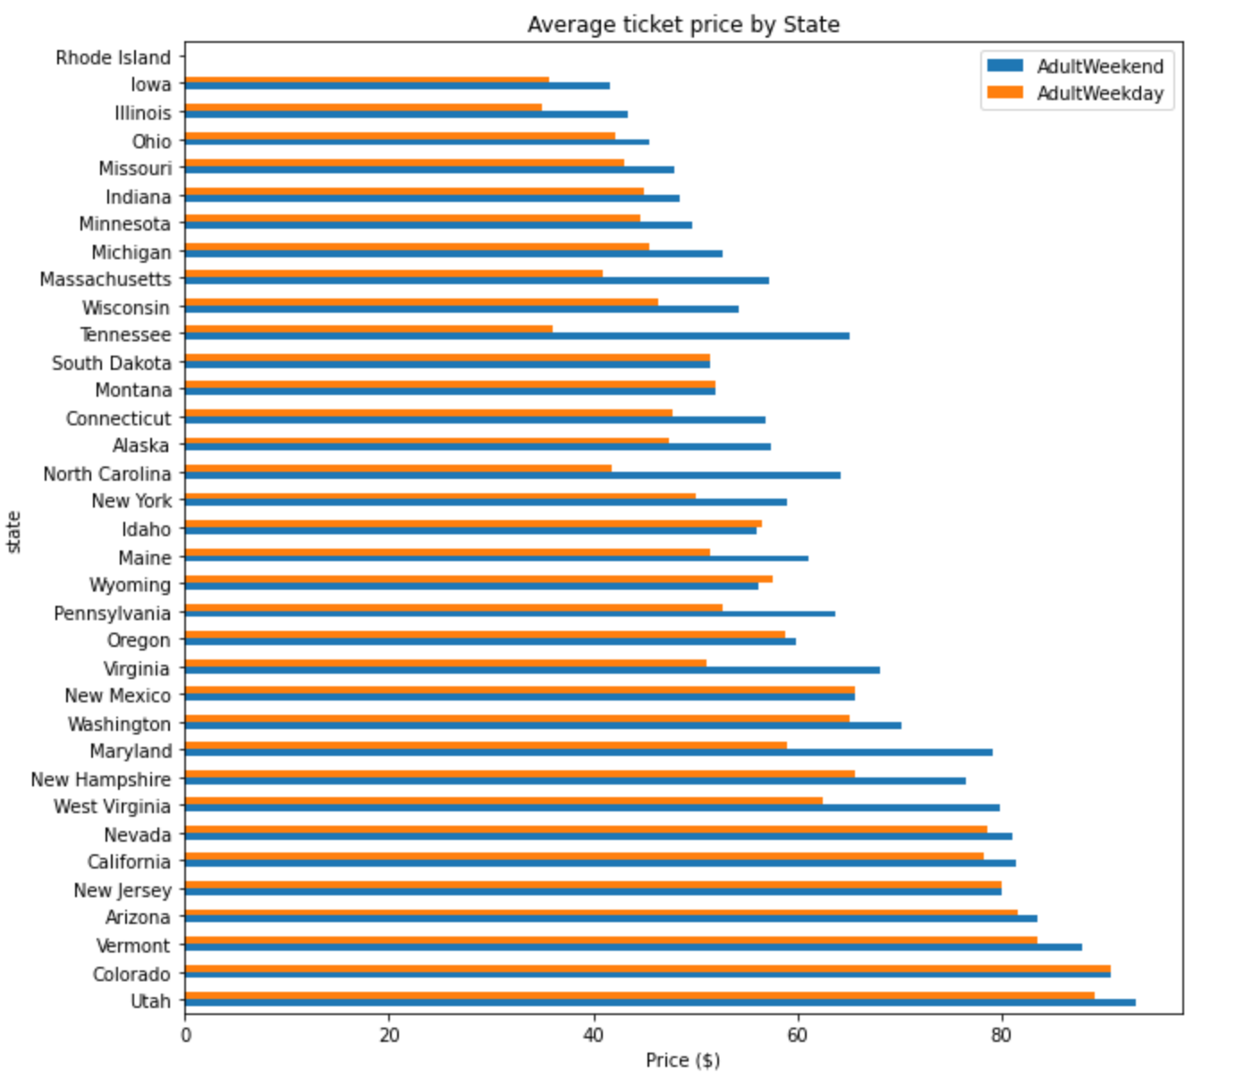
Modelling results and analysis
Average ticket price by state:

Slide 5
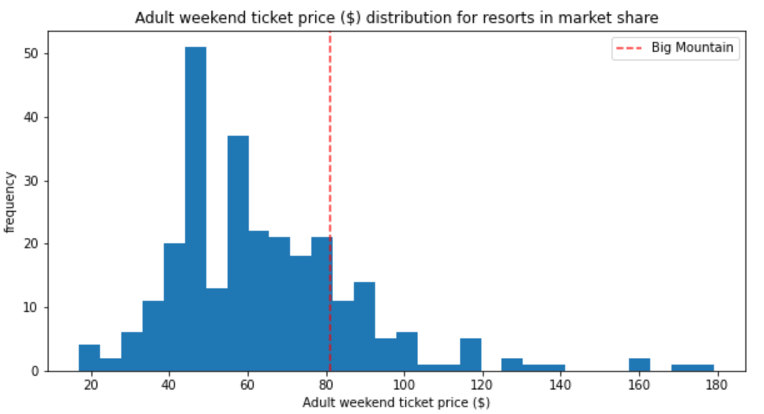
Modelling results and analysis
Comparison of current ticket price of Big Mountain resort with other locations:

Slide 6
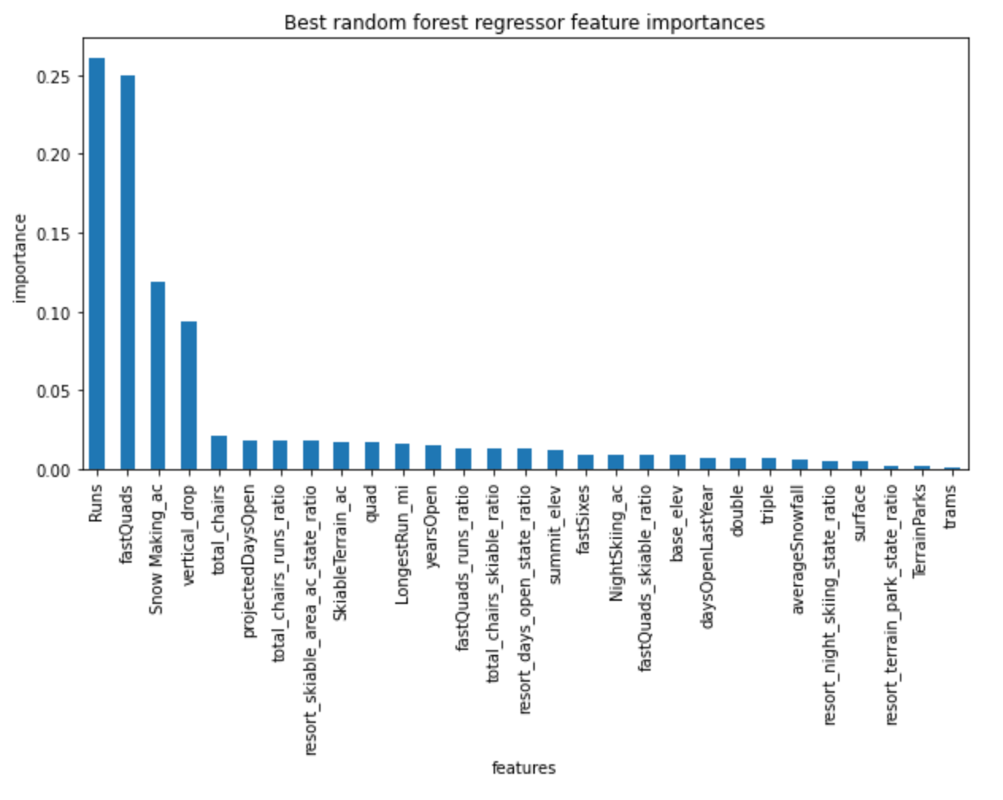
Modelling results and analysis
There are four important features:
FastQuads
Runs
Snow Making_ac
Vertical drop

Slide 7
Modelling results and analysis
Adding run, increasing vertical drop and installation of additional chair lift support to increase the ticket price by $1.3 over the season. The revenue is estimated about $2282609.
Decreasing the runs closed causes direct impact on the ticket price

Slide 8
Summary and conclusion
Comparison between the ticket price condition of Big Moutain resort and other locations have been performed in this research.
The most effective features on the ticket price for all of resorts have been obtained.
Data modelling based on the initial dataset was analyzed and this model was cross validated.
Adding run, increasing vertical drop and installation of additional chair lift support to increase the ticket price. So these features are required to propose a new amount for the price.
Increasing the longest run by 0.2 miles doesn't have any impact the results.

